Slide 1
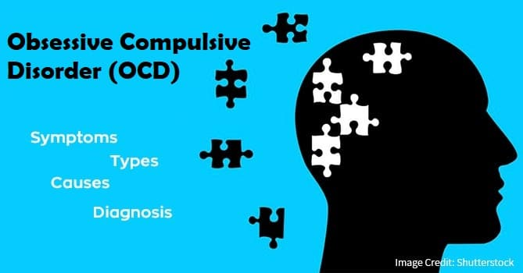
Analysis of OCD Patient Dataset: Demographics, Symptoms, and Treatment Insights

Slide 2
AGENDA
INTRODUCTION
AIM OF THE PROJECT
QUERIES
INSIGHTS
RECOMMENDATIONS
CONCLUSION

Slide 3
INTRODUCTION
Overview :
This project aims to analyze a dataset of patients diagnosed with Obsessive-Compulsive Disorder (OCD) using MySQL queries. By employing structured query techniques, we explore key aspects of the data, including demographic information, clinical details, and symptom severity, to gain a deeper understanding of OCD and its impact on patients.
Objective:
The primary objective of this project is to utilize SQL to analyze and extract meaningful insights from the OCD patient dataset.
Data Source :
The dataset used in this project, ocd_patient_dataset, contains detailed information about patients diagnosed with Obsessive-Compulsive Disorder (OCD). The data provides both demographic and clinical attributes, enabling comprehensive analysis and insights into OCD patient characteristics.

Slide 4

TOOLS USED
MySQL Workbench is a tool that helps you work with MySQL databases easily. It provides a user-friendly interface to create, manage, and analyze databases without needing to type commands all the time.

Slide 5
Where did you get the data from ?
Got it from Open Source

Slide 6
Aim of the project :
The aim of this project is to perform a comprehensive analysis of a dataset containing information about patients diagnosed with Obsessive-Compulsive Disorder (OCD). The analysis seeks to uncover key insights related to patient demographics, symptom severity, obsession and compulsion types, and medication usage. The project aims to answer various research questions, such as identifying trends in marital status, the relationship between age and gender, obsession types with higher severity scores, and medication patterns among OCD patients. Through this analysis, we aim to gain a deeper understanding of the characteristics and treatment patterns of OCD patients to inform clinical practice and future research in the field of mental health.

Slide 7

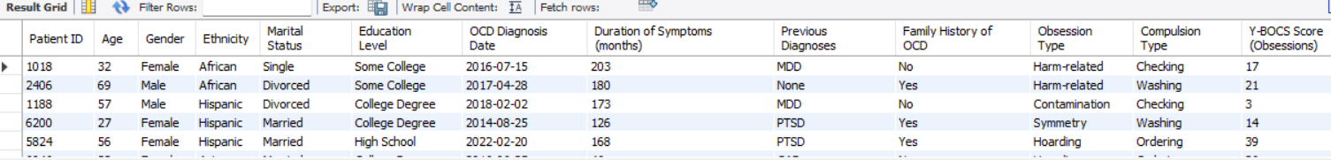
List all details of patients. SELECT * FROM ocd_patient_dataset ;

Slide 8

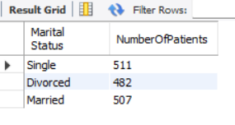
Count the number of patients with each marital status.
SELECT `Marital Status`, COUNT(*) AS Number Of Patients
FROM ocd_patient_dataset
GROUP BY `Marital Status`;

Slide 9
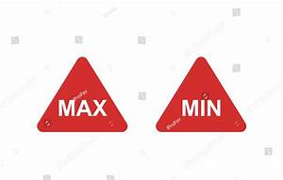
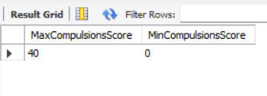

Find the maximum and minimum Y-BOCS score for compulsions.
SELECT MAX(`Y-BOCS Score (Compulsions)`) AS MaxCompulsionsScore, MIN(`Y-BOCS Score (Compulsions)`) AS MinCompulsionsScore FROM ocd_patient_dataset;

Slide 10

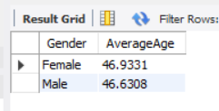
Group patients by gender and find the average age for each gender.
SELECT Gender, AVG(Age) AS AverageAge FROM ocd_patient_dataset
GROUP BY Gender;

Slide 11
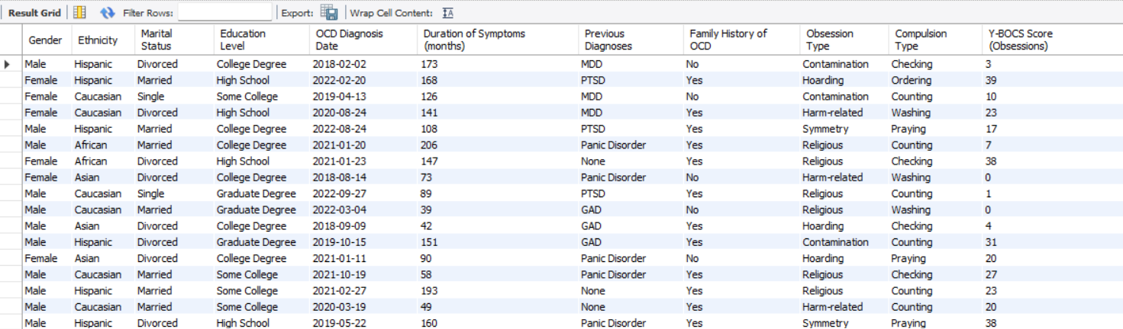

Find patients diagnosed with OCD after January 1, 2018.
SELECT * FROM ocd_patient_dataset WHERE `OCD Diagnosis Date` > '2018-01-01';

Slide 12

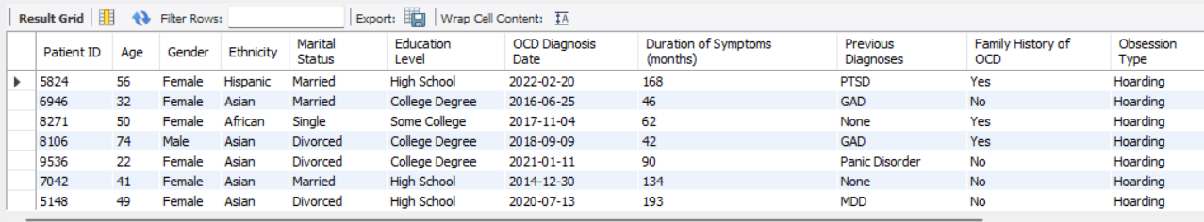
Find patients whose obsession type includes "Hoarding".
SELECT * FROM ocd_patient_dataset WHERE `Obsession Type` LIKE '%Hoarding%';

Slide 13

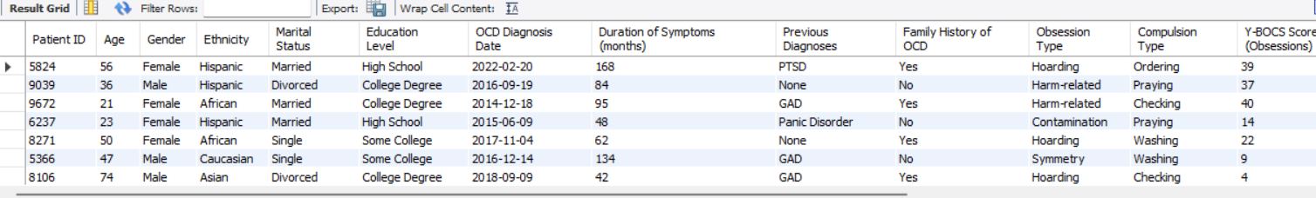
List patients who have not been prescribed any medication.
SELECT * FROM ocd_patient_datasetWHERE Medications IS NULL OR Medications = 'None';

Slide 14

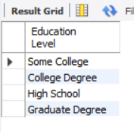
List all unique education levels of patients.
SELECT DISTINCT `Education Level` FROM ocd_patient_dataset;

Slide 15
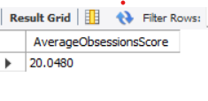
Calculate the average Y-BOCS score for obsessions across all patients.
SELECT AVG(`Y-BOCS Score (Obsessions)`) AS AverageObsessionsScore FROM ocd_patient_dataset;

Slide 16
OVERALL INSIGHTS
Symptom Severity: We can identify which obsession types (e.g., hoarding, contamination) are most severe, helping to tailor treatment for specific OCD behaviors.
Demographics and OCD: Analyzing factors like age, gender, and marital status can show how different groups experience OCD, such as if one gender tends to have more severe symptoms.
Medication Impact: Comparing patients with and without medications helps us understand how treatment affects symptom severity and whether medication is effective in reducing OCD symptoms
Diagnosis Trends: Looking at when patients were diagnosed (e.g., after January 1, 2018) reveals if OCD diagnoses are increasing over time and if more people are seeking help.
Patient Profiles: By grouping patients based on obsession types and other factors, we can focus on those with more severe symptoms, such as those with high Y-BOCS scores, for better-targeted care.

Slide 17
RECOMENDATION
Based on the analysis of the OCD patient dataset, one key recommendation is to focus on targeted treatment for patients with severe obsession types like hoarding or contamination, as they show higher Y-BOCS scores.
It's crucial to tailor treatment based on age and gender, as certain groups may experience OCD differently. Younger patients, for example, may need distinct therapeutic approaches compared to older individuals. For those not on medication, it’s important to evaluate alternative therapies and ensure regular monitoring to prevent symptom progression.
Important recommendation is to focus on early diagnosis and intervention. The longer OCD symptoms go untreated, the more severe they can become. By identifying and treating OCD earlier, patients can experience better long-term outcomes, with less risk of their symptoms worsening or becoming more difficult to manage.

Slide 18
CONCLUSION
analyzing the OCD patient dataset helps us understand how different factors, like obsession types, age, and gender, affect the severity of OCD symptoms. By focusing on targeted treatments for severe cases, tailoring care based on individual needs, and diagnosing OCD early, we can improve patient outcomes. Early treatment and personalized care plans are key to managing OCD more effectively and helping patients lead better lives.

